Slide 1



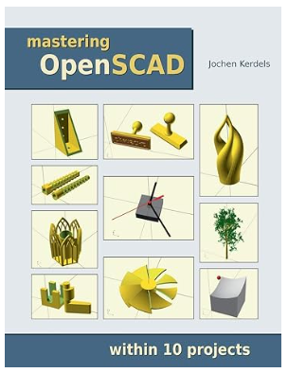
Mastering OpenSCAD within 10 projects
Hands-On Practices
Book: https://mastering-openscad.eu/
Repo: https://github.com/yasenstar/openscad

Slide 2
Mastering OpenSCAD within 10 projects
00 – OpenSCAD Basic
Hands-On Practices
Book: https://mastering-openscad.eu/
Repo: https://github.com/yasenstar/openscad

Slide 3
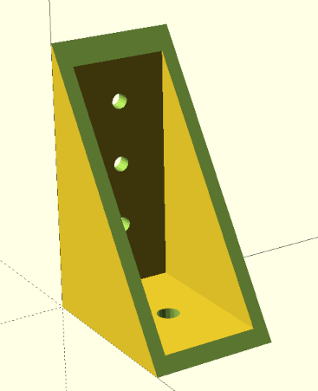
Mastering OpenSCAD within 10 projects
01 – Shelf Bracket
Hands-On Practices
Book: https://mastering-openscad.eu/
Repo: https://github.com/yasenstar/openscad

Slide 4
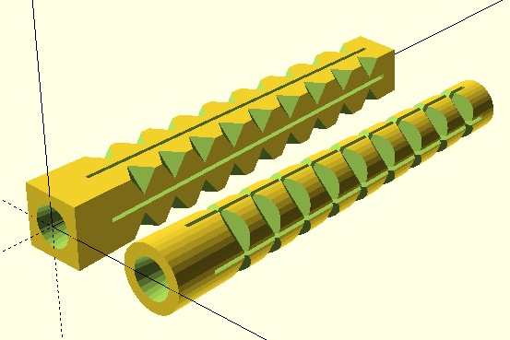
Mastering OpenSCAD within 10 projects
02 – Wall Anchor
Hands-On Practices
Book: https://mastering-openscad.eu/
Repo: https://github.com/yasenstar/openscad

Slide 5
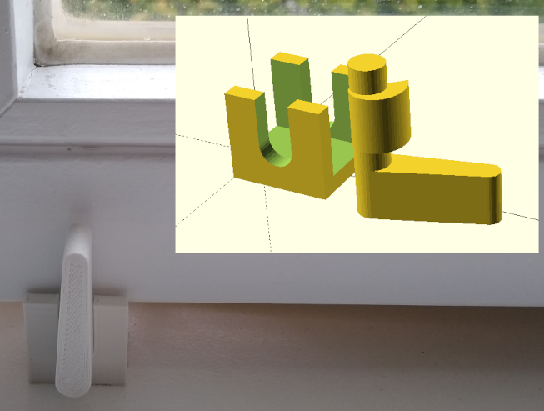
Mastering OpenSCAD within 10 projects
03 – Window Stopper
Hands-On Practices
Book: https://mastering-openscad.eu/
Repo: https://github.com/yasenstar/openscad

Slide 6
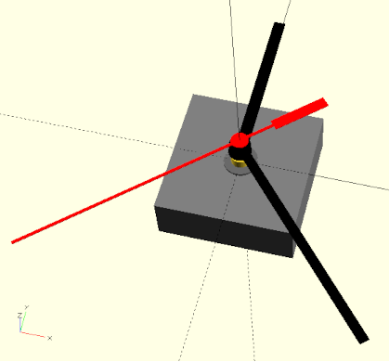
Mastering OpenSCAD within 10 projects
04 – Clock Movement Mockup
Hands-On Practices
Book: https://mastering-openscad.eu/
Repo: https://github.com/yasenstar/openscad

Slide 7
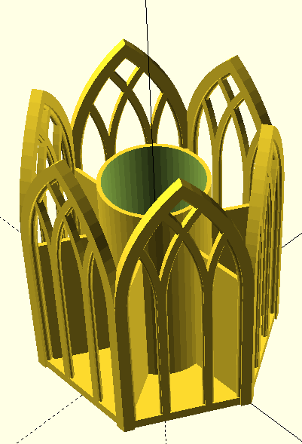
Mastering OpenSCAD within 10 projects
05 – Pen Holder
Hands-On Practices
Book: https://mastering-openscad.eu/
Repo: https://github.com/yasenstar/openscad

Slide 8
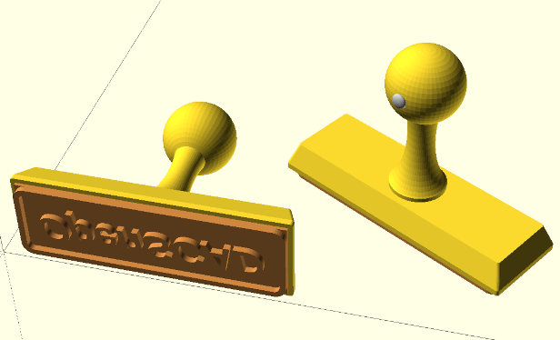
Mastering OpenSCAD within 10 projects
06 – Stamp
Hands-On Practices
Book: https://mastering-openscad.eu/
Repo: https://github.com/yasenstar/openscad

Slide 9
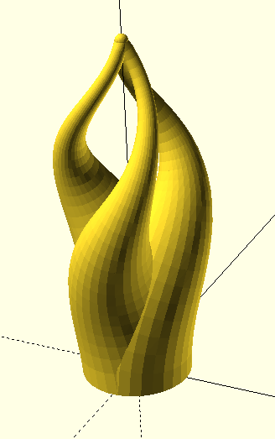
Mastering OpenSCAD within 10 projects
07 – Flame Sculpture
Hands-On Practices
Book: https://mastering-openscad.eu/
Repo: https://github.com/yasenstar/openscad

Slide 10
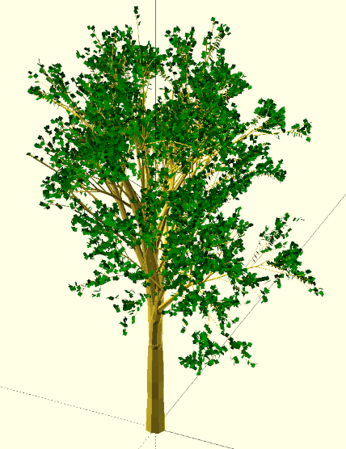
Mastering OpenSCAD within 10 projects
08 – Recursive Tree
Hands-On Practices
Book: https://mastering-openscad.eu/
Repo: https://github.com/yasenstar/openscad

Slide 11
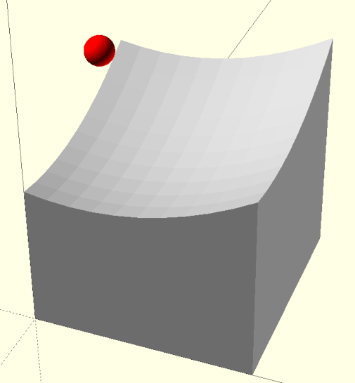
Mastering OpenSCAD within 10 projects
09 – Parabolic Reflector
Hands-On Practices
Book: https://mastering-openscad.eu/
Repo: https://github.com/yasenstar/openscad

Slide 12
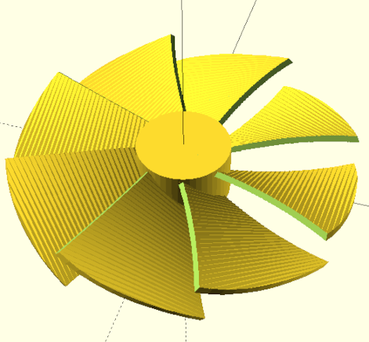
Mastering OpenSCAD within 10 projects
10 – Fan Wheel
Hands-On Practices
Book: https://mastering-openscad.eu/
Repo: https://github.com/yasenstar/openscad

Slide 13
